Slide 1
BILLY-BUDDY AGAINST CYBERBULLYING
PIP2001 Capstone Project
Final-ppt
Batch Number:
Under the Supervision of,
Ms.PRIYANKA NIRANJAN SAVADEKAR
Professor / Associate Professor / Assistant Professor
School of Computer Science and Engineering
Presidency University
Roll Number | Student Name
20211CCS0174 | ADARSH T N
20211CCS0157 | HARISH SHIROL
20211CCS0145 | AKASH C TOTAD
20211CCS0178 | SHIVA VIGNESH
Name of the Program: PIP 2001 (CAPSTONE PROJECT)
Name of the HoD: Dr. Anandaraj S P
Name of the Program Project Coordinator: Dr. Sharmasth Vali Y
Name of the School Project Coordinators: Dr. Sampath A K / Dr. Abdul Khadar A / Mr. Md Ziaur Rahman

Slide 2
Content
INTRODUCTION
Existing method Drawback
Proposed Method
Objectives
Methodology/Modules
Architecture
Hardware/software components
Timeline of Project
Expected Outcomes
Conclusion
Github Link
References
Project work mapping with SDG

Slide 3
Introduction
Cyberbullying is a significant and growing problem in the digital age, characterized by the use of electronic communication to bully, harass, or intimidate individuals. This behavior can lead to severe psychological, emotional, and sometimes physical consequences for victims. Despite the widespread use of social media and online platforms, there is a lack of effective measures to prevent, identify, and address cyberbullying incidents. The challenge lies in developing comprehensive strategies that involve education, technology, and policy to create a safer online environment for all users.

Slide 4
Literature Review
Sr no | Author name & year | Title of paper | Methdology user | Accuracy | Dataset | Link
1 | Wenting Zou a, Qian Yang b, Dominic DiFranzo c, Melissa Chen d, Winice Hui d, Natalie N. Bazarova d 2024 | Social Media Co-pilot: Designing a chatbot with teens and educators to combat cyberbullying | social media co-pilot chatbot | High | Many combined data with own dataset | https://www.sciencedirect.com/science/article/pii/S2212868924000497
2 | Laura Iseut Lafrance St-Martin & Stéphane Villeneuve,2024 | The uses of chatbots in the context of children and teenagers bullying | RISMA method | medium | Appendix 1dataset | https://www.tandfonline.com/doi/full/10.1080/2331186X.2024.2312032?scroll=top&needAccess=true#d1e189
3 | Mendoza-Pinto, 2023 | Artificial Intelligence in the Fight Against Bullying: Integration of ChatGPT in an Emotional Support Chatbo | Telegram platform and the GPT Chat model | High | Google sheet own dataset | https://ceur-ws.org/Vol-3691/paper30.pdf
4 | Michael A. Hedderich, Natalie N. Bazarova, Wenting Zou, Ryun Shim, Xinda Ma, Qian YangAuthors,2024 | A Piece of Theatre: Investigating How Teachers Design LLM Chatbots to Assist Adolescent Cyberbullying Education | Artificial intelligence.LLM | High | Whatsapp data base | https://arxiv.org/pdf/2402.17456
5 | Yulia Kumar 1,*,Kuan Huang 1,Angelo Perez 1,Guohao Yang 1,J. Jenny Li 1,Patricia Morreale 1,Dov Kruger 2 andRaymond Jiang,2024 | ias and Cyberbullying Detection and Data Generation Using Transformer Artificial Intelligence Models and Top Large Language Models | Hello GPT-4o | High | DeBERTa, Longformer, BigBird, HateBERT, MobileBERT, DistilBERT, BERT, RoBERTa, ELECTRA, and XLNet | https://www.mdpi.com/2079-9292/13/17/3431
6
7

Slide 5
Existing method Drawback
Accuracy Issues:
Cultural and Linguistic Bias
Real-Time Processing Limitations
Difficulty in Detecting Emotional and Indirect bullying
Inconsistent Action Across Platforms
Limited Preventive Features
Privacy and Ethical Concerns

Slide 6
Proposed Method
The proposed model aims to improve upon existing cyberbullying detection systems by integrating real-time detection, multimodal content analysis, contextual understanding, and proactive user engagement.
User Interaction Layer (Frontend)
2. Cyberbullying Detection Layer
3.Contextual Awareness and History Analysis
4. Proactive Prevention Module
5. Reporting and Moderation System
6. Action and Punitive Layer

Slide 7
Objectives
The objectives of a cyberbullying prevention software are aimed at addressing the harmful impacts of cyberbullying by offering preventive measures, detection mechanisms, and providing support to victims. Here are some key objectives
Detect Harmful Content
Monitor Online Interactions
Provide Reporting and Support Mechanisms
Educate and Raise Awareness
Offer Real-Time Alerts and Notifications
Encourage Positive Online Behavior
Offer Psychological Support Resources

Slide 8
Methodology/Modules
Natural Language Processing (NLP) Module
LMM (Large Language Model) Module
Machine Learning (ML)
Anomaly Detection Models
Privacy and Legal Compliance Module

Slide 9
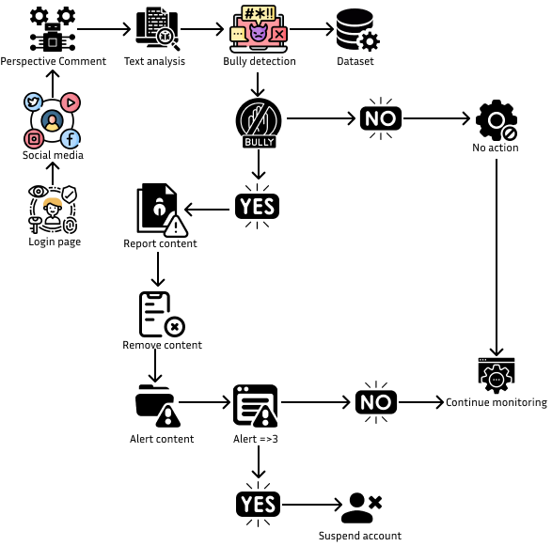
Architecture

Slide 10
Hardware/software components
Software Requirements
Operating System:
Windows, macOS, Linux
Programming Languages:
Frontend: HTML, CSS, JavaScript (for web-based applications).
Backend: Python, Java, Node.js, PHP, Ruby, etc., for server-side processing and data handling.
Database:
SQL-based: MySQL, PostgreSQL, SQLite.
NoSQL-based: MongoDB, Firebase
Natural Language Processing (NLP) Tools:
Tools like Google's Cloud Natural Language API, IBM Watson, or open-source libraries
Encryption & Data Security
Hardware: Server, End-User Devices, Graphics Processing, 8gb RAM

Slide 11
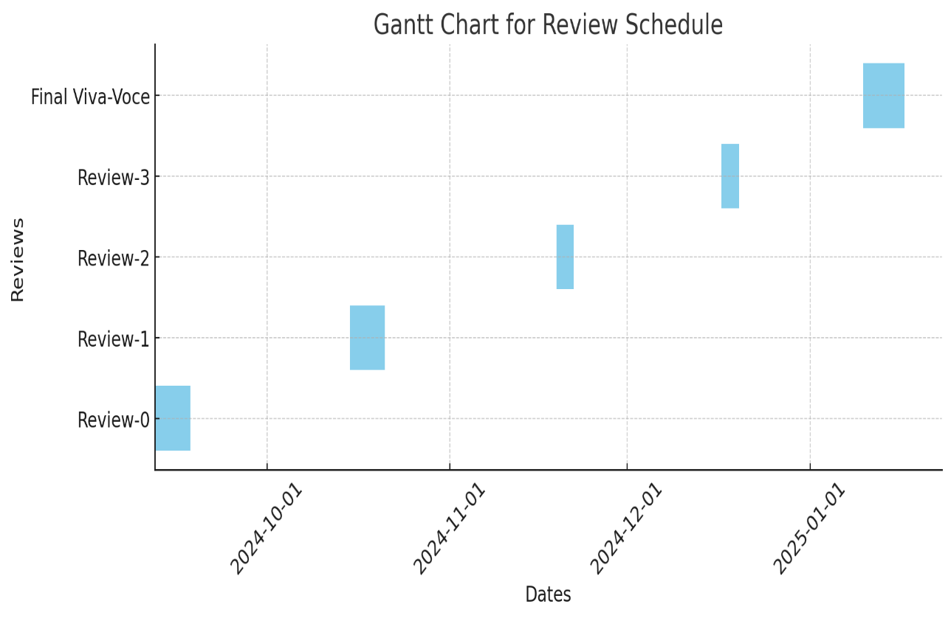
Timeline of Project

Slide 12
Expected Outcomes
Increased Awareness About Cyberbullying
Reduction in Cyberbullying Incidents
Better Digital Citizenship
Development of Support Networks
Improved Mental Health and Well-Being
Promotion of Safe Online Spaces

Slide 13
Conclusion
BILLY-BUDDY AGAINST CYBERBULLYING" is a powerful initiative designed to address the growing issue of cyberbullying in today's digital age. Through a comprehensive approach that focuses on awareness, education, and empowerment, the program aims to create a safer and more respectful online environment for all users, especially young people.

Slide 14
Github Link
Github Link : https://github.com/Akash-C-T/BILLY.git

Slide 15
References
Reference: Alzahrani, M., Aljohani, N.R., & Alharbi, F. (2024). Development of a Cyberbullying Prevention Software. Procedia Computer Science, 207, 237-244. https://doi.org/10.1016/j.procs.2024.03.025

Slide 16
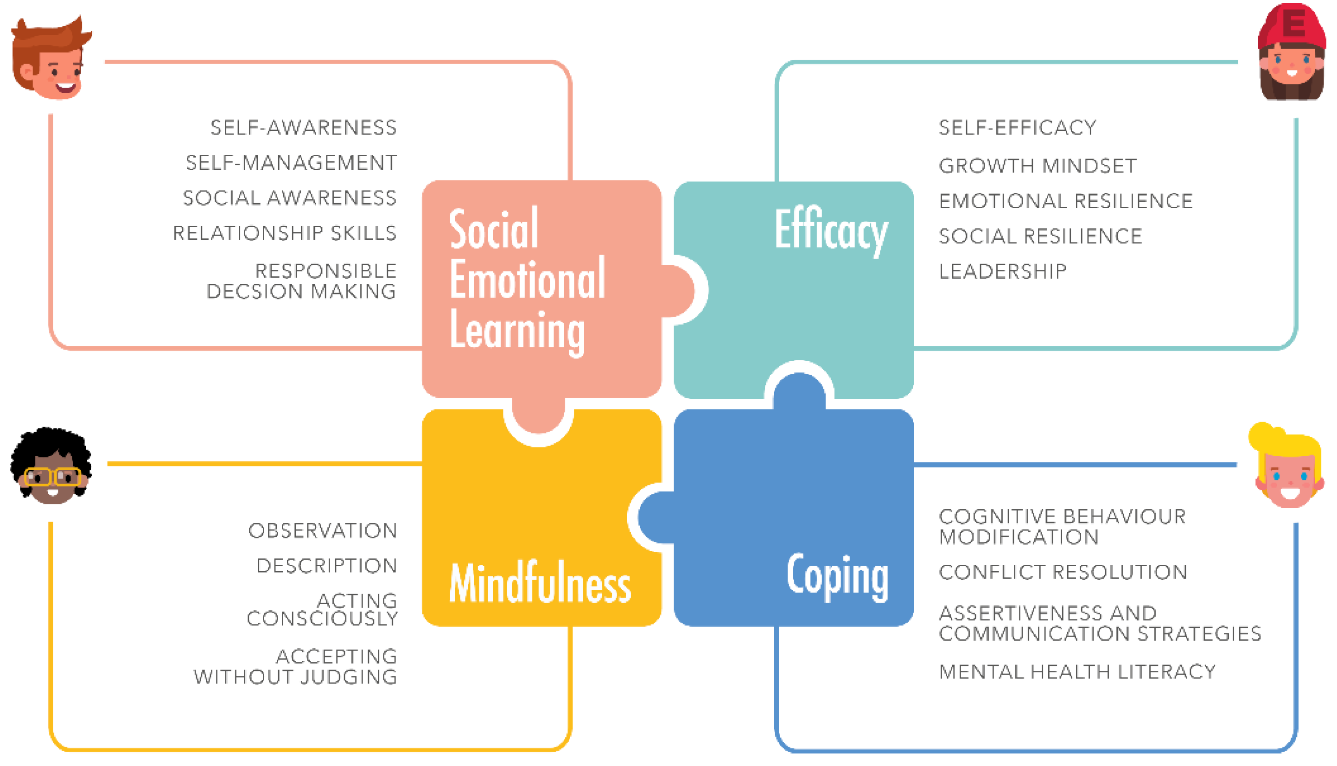

Project work mapping with SDG

Slide 17
Thank You

